Slide 1
Caribbean Restaurant Chain Looking to Expand in New York City

Slide 2
Introduction
A Texas based chain of Carribean restaurants is planning to expand in Brooklyn and Queens boroughs of New York City. They have approached a data scientist to analyze which neighborhood(s) of these boroughs have heavier footfall as far as Carribean food is concerned.
Data analysis will be performed to determine clusters of neighborhoods where Carribean food is popular, and hence will be a a good idea for the restaurant chain to first explore these neighborhoods for expansion of business.

Slide 3
Data Sources
Data for neighborhoods in Brooklyn and Queens will come from
https://cf-courses-data.s3.us.cloud-object-storage.appdomain.cloud/IBMDeveloperSkillsNetwork-DS0701EN-SkillsNetwork/labs/newyork_data.json
Data for venues will come from FourSquare.

Slide 4
Methodology
Project methodology involved creating clusters of neighborhoods in Brooklyn and Queens boroughs and find the cluster(s) of neighborhoods where Caribbean restaurants were a preferred venue.
Project was completed using Python and involved the following steps:­­
Imported needed Python libraries
Downloaded dataset for New York City containing information about boroughs, neighborhoods, and their longitudes and latitudes.
Two separate dataframes were created, one each for Brooklyn and Queens boroughs.
For each borough, information form FourSquare was used to obtain the list of venues and venue categories within a 5000 meters radius of different neighborhoods. This exercise yielded a list of 7000 and 8006 venues for Brooklyn and Queens respectively. There were 230 unique venue categories for Brooklyn while Queens had 259 unique categories.

Slide 5
Results and Observations
Clustering exercise identified that Cluster 4 in each of the two neighborhoods had a preponderance of Caribbean restaurants as first/second/third venue. Other neighborhood clusters did not have this marked preference for the Caribbean food. These neighborhood clusters for Brooklyn (Artifacts #1 and #2) and Queens (Artifacts #3 and #4) are shown in the next 4 slides.

Slide 6
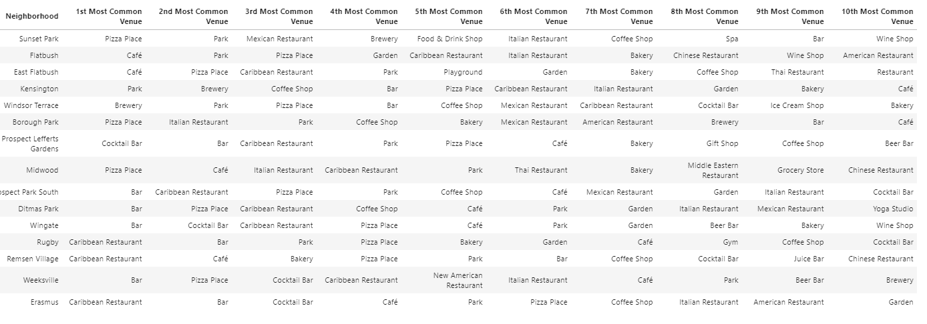
Artifact #1: Neighborhoods in Cluster 4 for Brooklyn

Slide 7
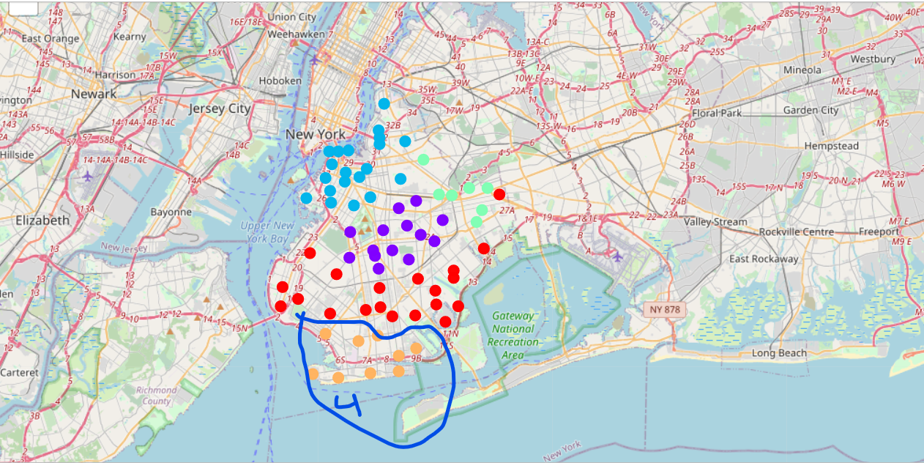
Artifact #2: Mapping Neighborhoods in Cluster 4 for Brooklyn

Slide 8
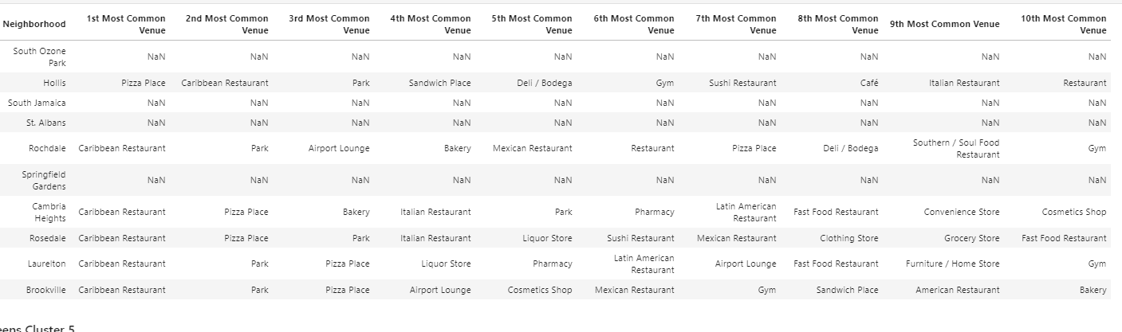
Artifact #3: Neighborhoods in Cluster 4 for Queens

Slide 9
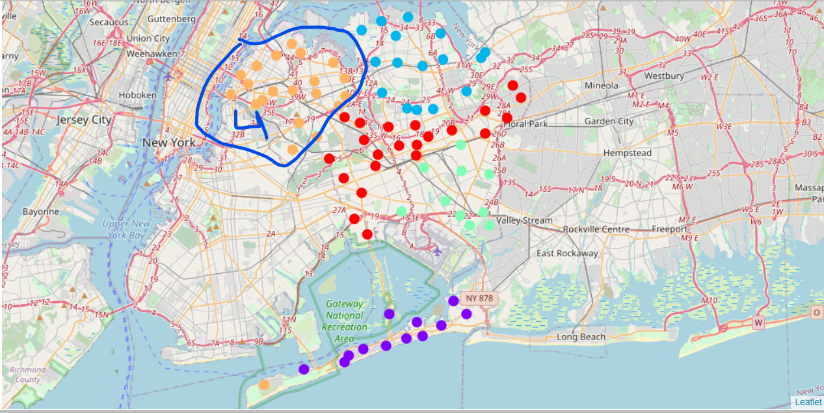
Artifact #4: MappingNeighborhoods in Cluster 4 for Queens

Slide 10
Conclusion
Based on the results of this thorough data analysis, the data analyst was able to identify the clusters in Brooklyn and Queens boroughs that had a preference for the Caribbean food. The Caribbean food chain from Texas will be better off focusing its expansion efforts in these neighborhoods.

